Slide 1

APT 1040: INTRODUCTION TO WEB DESIGN AND APPLICATIONS
Notes:
Note from Chuck. If you are using these materials, you can remove my name and URL from this replace it with your own, but please retain the CC-BY logo on the first page as well as retain the entire last page when you remix and republish these slides.

Slide 2
About the PHP Language
Syntax is inspired by C
  Curly braces, semicolons, no signficant whitespace
Syntax inspired by perl
  Dollar signs to start variable names, associative arrays
Extends HTML to add segments of PHP within an HTML file.

Slide 3
Philosphy of PHP
You are a responsible and intelligent programmer
You know what you want to do
Some flexibility in syntax is OK - style choices are OK
Lets make this as convienent as possible
Sometimes errors fail silently

Slide 4
How PHP generates
HTML/JS Web pages
Client Browser
1
4
3
PHP module
Apache
2
1: Client from browser send HTTP request (with POST/GET variables)
2: Apache recognizes that a PHP script is requested and sends the request to PHP module
3: PHP interpreter executes PHP script, collects script output and sends it back
4: Apache replies to client using the PHP script output as HTML output

Slide 5
Hello World! (web oriented)
<html>
<head>
<title>My personal Hello World! PHP script</title>
</head>
<body>
<?
echo “Hello World!”;
?>
</html>
PHP tag, allow to insert PHP code. Interpretation by PHP module will substitute the code with code output

Slide 6
<h1>Hello from Lawrence HTML Page</h1>
<p>
<?php
echo "Hi there.\n";
$answer = 6 * 7;
echo "The answer is $answer, what ";
echo "was the question again?\n";
?>
</p>
<p>Yes another paragraph.</p>

Slide 7
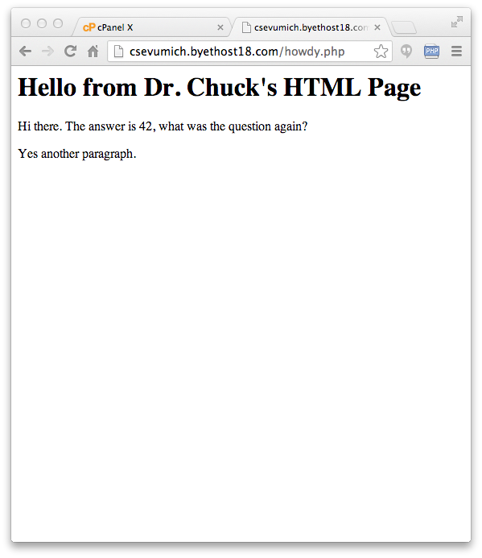
<h1>Hello from Dr. Chuck's HTML Page</h1>
<p>
<?php
echo "Hi there.\n";
$answer = 6 * 7;
echo "The answer is $answer, what ";
echo "was the question again?\n";
?>
</p>
<p>Yes another paragraph.</p>

Slide 8
Key Words
abstract and array() as break case catch class clone const continue declare default do else elseif end declare endfor endforeach endif endswitch endwhile extends final for foreach function global goto if implements interface instanceof namespace new or private protected public static switch $this throw try use var while xor
http://php.net/manual/en/reserved.php

Slide 9
Variable Names
Start with a dollar sign ($) followed by a letter or underscore, followed by any number of letters, numbers, or underscores
Case matters
$abc = 12;
$total = 0;
$largest_so_far = 0;
abc = 12;
$2php = 0;
$bad-punc = 0;
http://php.net/manual/en/language.variables.basics.php

Slide 10
Variable Name Weirdness
Things that look like variables but are missing a dollar sign can be confusing
$x = 2;
$y = x + 5;
print $y;
$x = 2;
y = $x + 5;
print $x;
5
Parse error

Slide 11
Expressions
Completely normal like other languages ( + - / * )
More agressive implicit type conversion
<?php
$x = "15" + 27;
echo($x);
echo("\n");
?>
42

Slide 12
Output
<?php
$x = "15" + 27;
echo $x;
echo("\n");
echo $x, "\n";
print $x;
print "\n";
print($x);
print("\n");
?>
echo is a language construct - can be treated like a function with one parameter. Without parenthesis, it accepts multiple parameters.
print is a function - only one parameter but parenthesis are optional so it can look like a language construct

Slide 13
Conditional - if
Logical operators ( == != < > <= >= and or ! )
Curly braces
<?php
$ans = 42;
if ( $ans == 42 ) {
print "Hello world!\n";
} else {
print "Wrong answer\n";
}
?>
Hello World!

Slide 14
Whitespace does not matter
<?php
$ans = 42;
if ( $ans == 42 ) {
print "Hello world!\n";
} else {
print "Wrong answer\n";
}
?>
<?php $ans = 42; if ( $ans == 42 ) { print
"Hello world!\n"; } else { print "Wrong answer\n"; }
?>

Slide 15
What Style do You Prefer?
<?php
$ans = 42;
if ( $ans == 42 )
{
print "Hello world!\n";
}
else
    {
print "Wrong answer\n";
}
?>
<?php
$ans = 42;
if ( $ans == 42 ) {
print "Hello world!\n";
} else {
print "Wrong answer\n";
}
?>
Aesthetics

Slide 16
Associative Arrays
Like Python Dictonaries+Lists - but more powerful
Can be key => value or simply indexed by numbers
Ignore two-dimensional arrays for now...

Slide 17
Integer Indices
<?php
$stuff = array("Hi", "There");
echo $stuff[1], "\n";
?>
There

Slide 18
Integer Indices
<?php
$stuff = array();
$stuff[] = "Hello";
$stuff[] = "World";
echo $stuff[1], "\n";
?>
World

Slide 19
Looping Through an Array
<?php
$stuff = array("name" => "Chuck",
"course" => "SI664");
foreach($stuff as $k => $v ) {
echo "Key=",$k," Val=",$v,"\n";
}
?>
Key=name Val=Chuck
Key=course Val=SI664

Slide 20
Variable Name Weirdness
Things that look like variables but are missing a dollar sign as an array index are unpredictable....
$x = 5;
$y = array("x" => "Hello");
print $y[x];
Hello

Slide 21
Strings
String literals can use single quotes or double quotes
The backslash (\) is used as an "escape" character
Strings can span multiple lines - the newline is part of the string
In double-quoted strings variable values are expanded
http://php.net/manual/en/language.types.string.php

Slide 22
<?php
echo 'this is a simple string';
echo 'You can also have embedded newlines in
strings this way as it is
okay to do';
// Outputs: Arnold once said: "I'll be back"
echo 'Arnold once said: "I\'ll be back"';
// Outputs: This will not expand: \n a newline
echo 'This will not expand: \n a newline';
// Outputs: Variables do not $expand $either
echo 'Variables do not $expand $either';
?>
Single Quote

Slide 23
Double Quote
<?php
echo "this is a simple string\n";
echo "You can also have embedded newlines in
strings this way as it is
okay to do";
// Outputs: This will expand:
// a newline
echo "This will expand: \na newline";
// Outputs: Variables do 12
$expand = 12;
echo "Variables do $expand\n";
?>

Slide 24
<?php
echo 'This is a test'; // This is a c++ style comment
/* This is a multi line comment
yet another line of comment */
echo 'This is yet another test';
echo 'One Final Test'; # This is a shell-style comment
?>
http://php.net/manual/en/language.basic-syntax.comments.php

Slide 25
Summary
This is a sprint through the language features of PHP

Slide 26

Acknowledgements / Contributions
These slides are Copyright 2010- Charles R. Severance (www.dr-chuck.com) as part of www.php-intro.com and made available under a Creative Commons Attribution 4.0 License. Please maintain this last slide in all copies of the document to comply with the attribution requirements of the license. If you make a change, feel free to add your name and organization to the list of contributors on this page as you republish the materials.
Initial Development: Charles Severance, University of Michigan School of Information
Insert new Contributors and Translators here including names and dates
Continue new Contributors and Translators here
Notes:
Note from Chuck. Please retain and maintain this page as you remix and republish these materials. Please add any of your own improvements or contributions.

Slide 27
Lab
Open Lab 11 In week 11: Learn to submit HTML data to MySQL database using php

